Slide 1
Daneshkar Presentation
for
Data Analysis
of
Tennis Games
Partipants:
Marzie Dezfoulianrad
Seyyed Mohammad Osuli Dezfuli Zade
Mozhgan Mohammadi

Slide 2
We'll analyze tennis game data by exploring 17 key questions from a large dataset of matches. Our presentation will highlight the insights we've uncovered from this rich information.

Slide 3
Question 1 :
How many tennis players are included in the dataset?

Slide 4
Number of Tennis Players in the Dataset (Excluding Nulls)
Unique Home Team Players 2447
Unique Away Team Players 2479
Total Unique Players (Combined) 2644

Slide 5
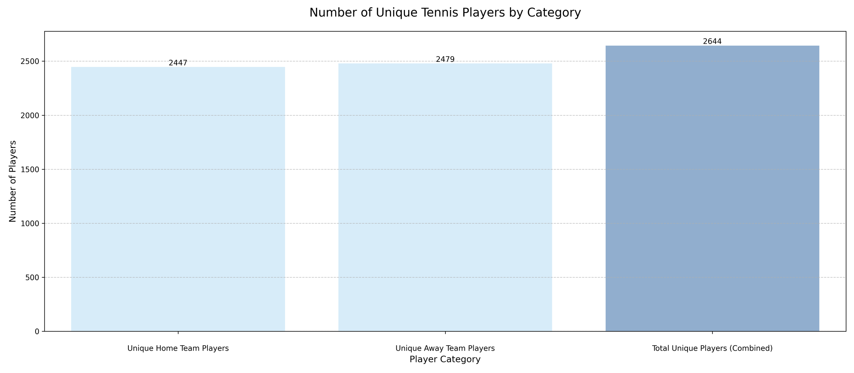

Slide 6
Question 2 :
What is the average height of the players?

Slide 7
Combined all players data shape:
Median height used for filling NaN values: 1.83
The Arithmetic Mean of Player Heights is: 1.83
Mode of Height: 1.83

Slide 8
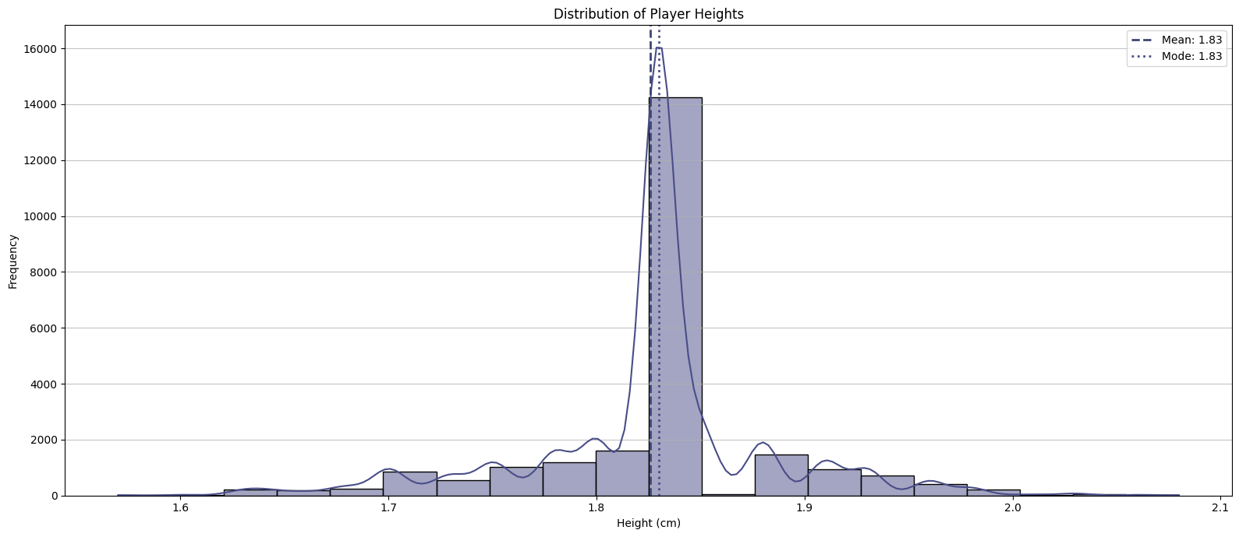

Slide 9
We have a tall, narrow bell curve peaking at 1.83 cm.
About 95% of all players fall between 1.78 cm and 1.88 cm.
There is a light left skew, which shows there are more players below 1.83 cm than above it and if we look closely we see that the tail stretches slightly more to the left than to the right.

Slide 10
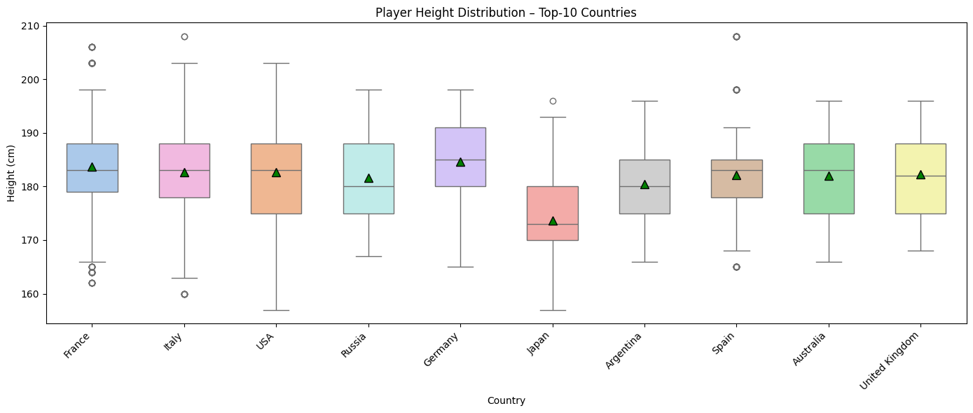

Slide 11
Question 3 :
Which player has the highest number of wins?

Slide 12
Total Actual Winners Found : 2320
Winning Full Name
Popko, Dmitry 29
Chidekh, Clement 22
Gengel, Marek 21
Jianu, Filip Cristian 21
Dellien Velsco, Murkel Alejandro 20

Slide 13
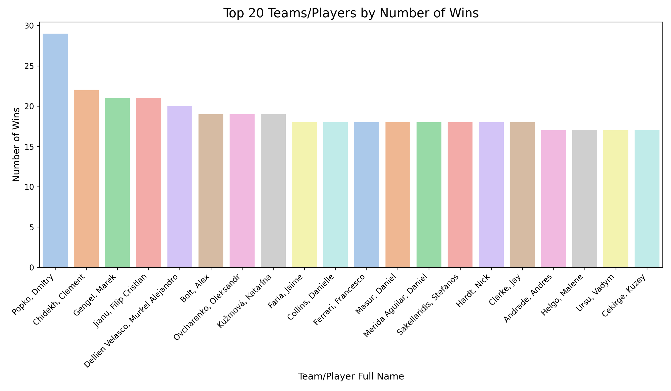

Slide 14
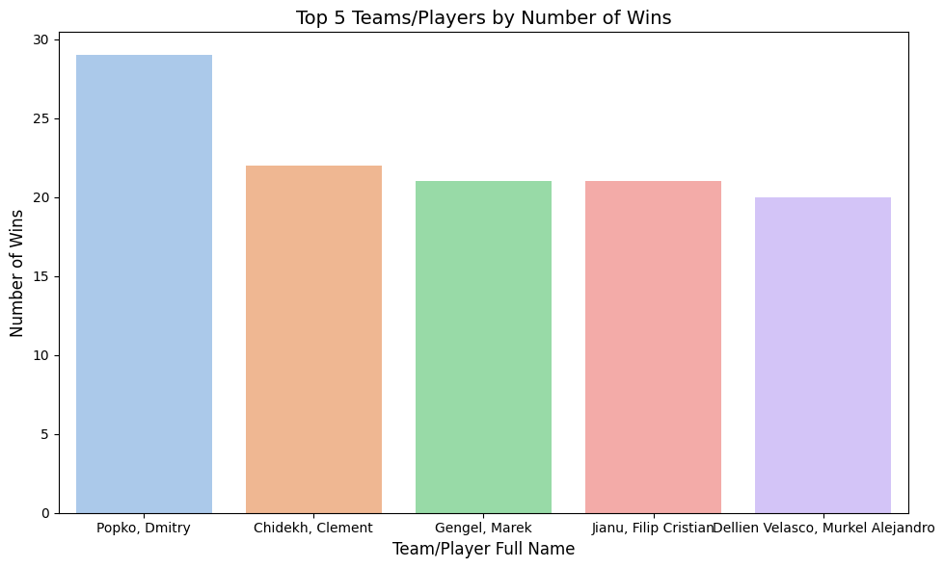

Slide 15
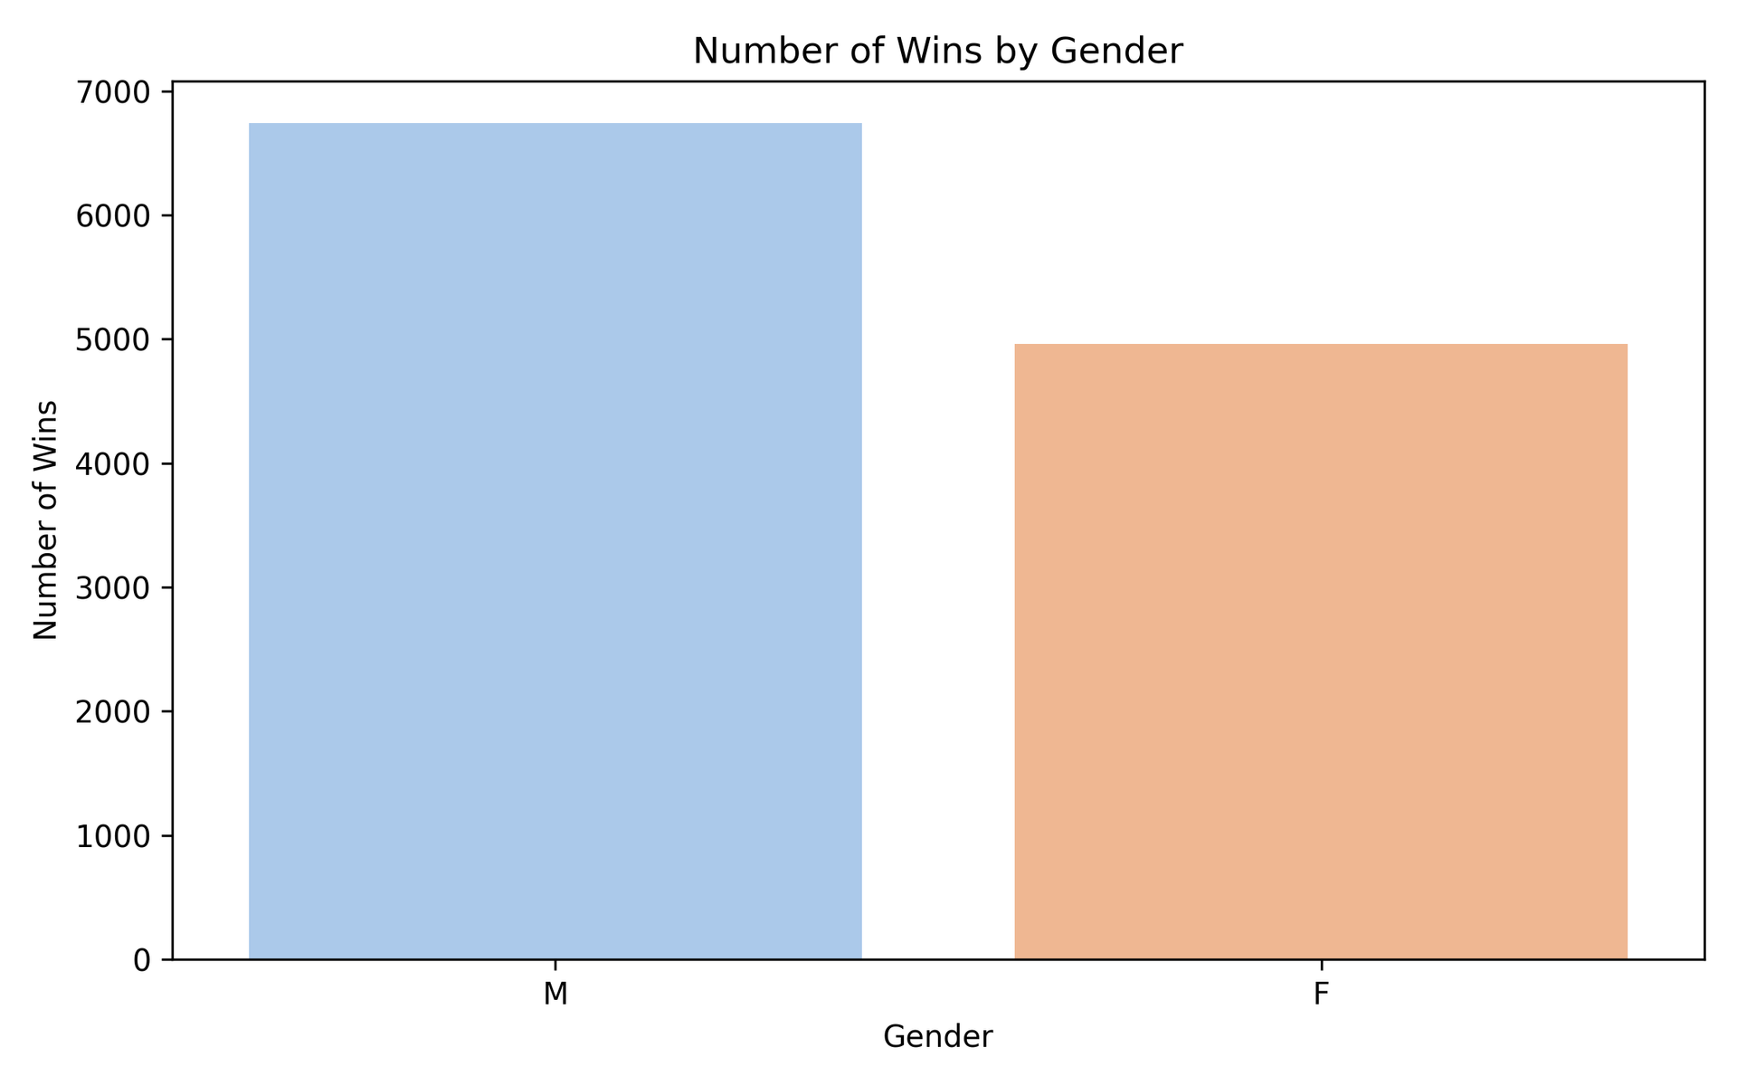

Slide 16
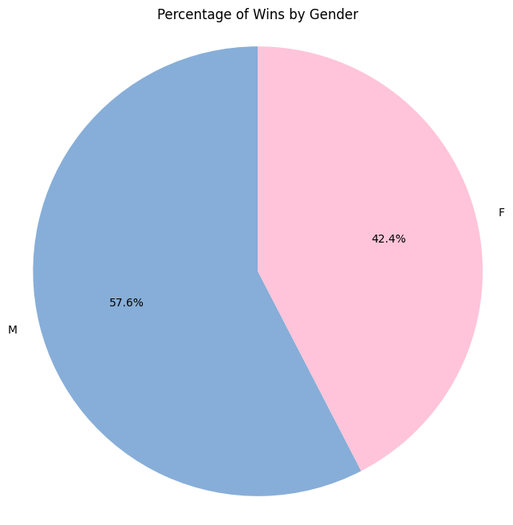

Slide 17
Question 4 :
What is the longest match recorded in terms of duration?

Slide 18
ID of the Longest Match: 12151527
Duration: 0h 15m 31s

Slide 19
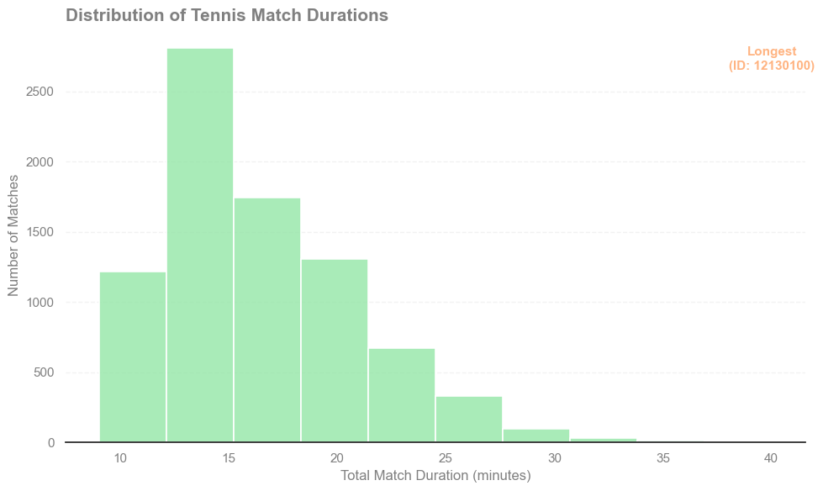

Slide 20
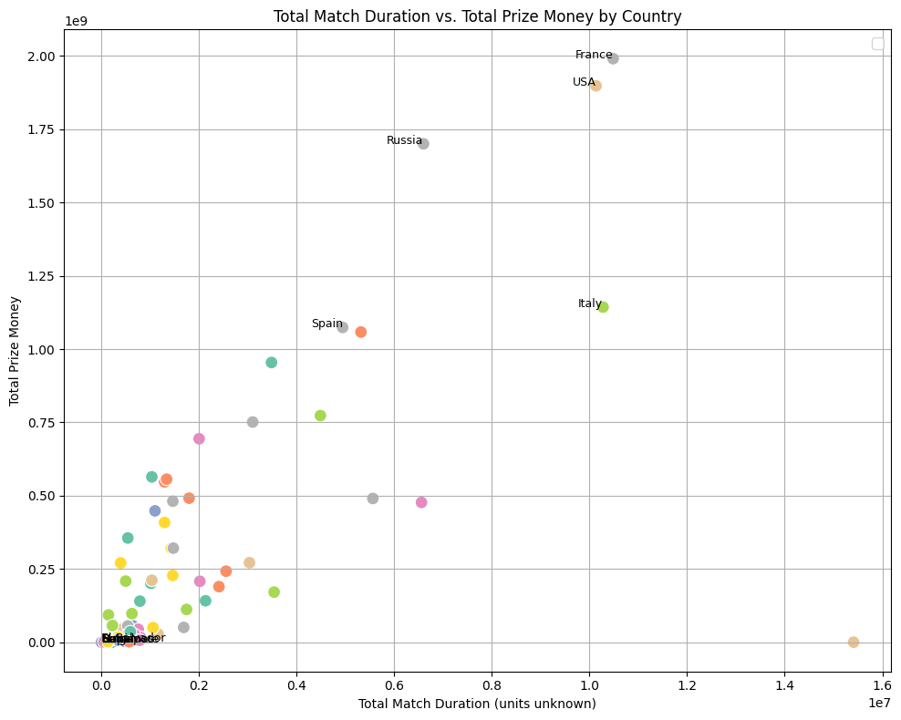

Slide 21
Question 5 :
How many sets are typically played in a tennis match?

Slide 22
The average number of sets played per match is: 2.28

Slide 23
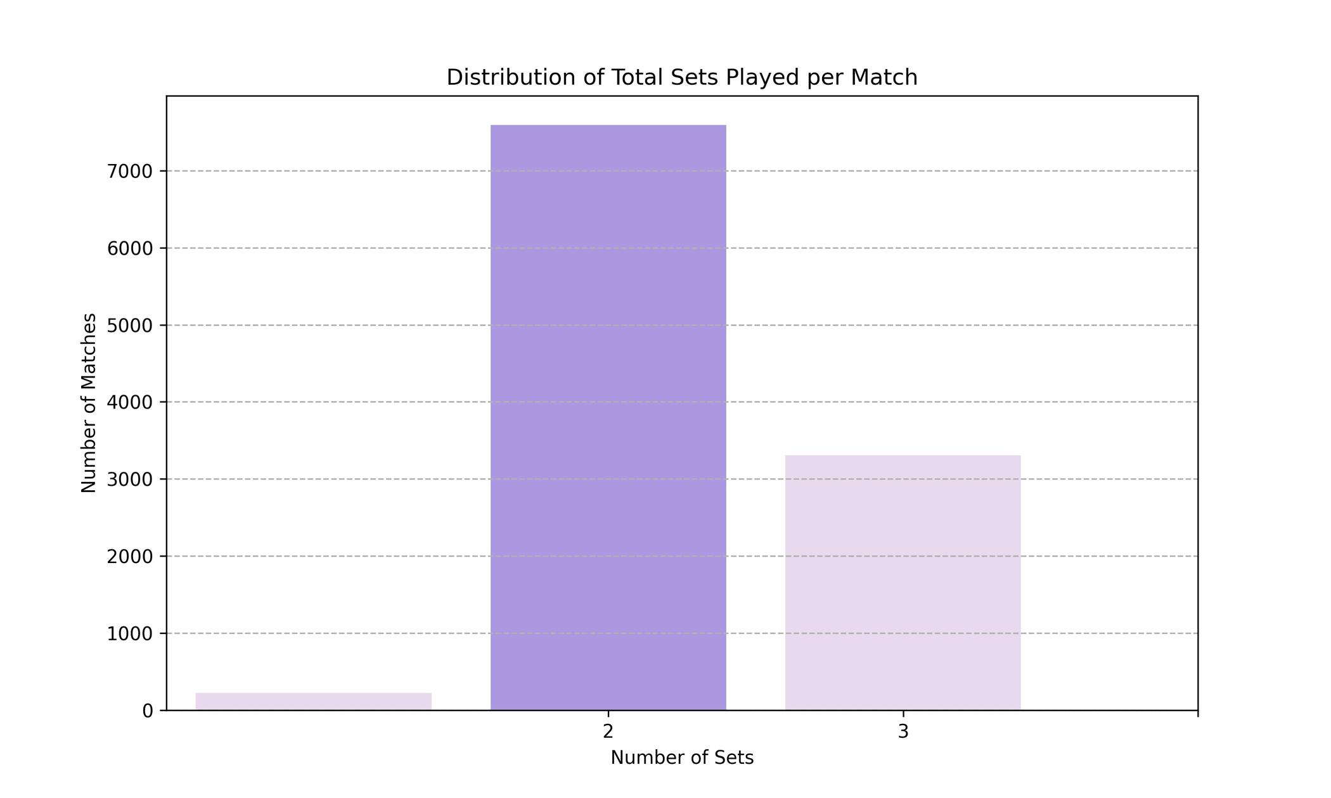

Slide 24
winner_plays
right-handed 87.744843%
left-handed 12.255157%

Slide 25
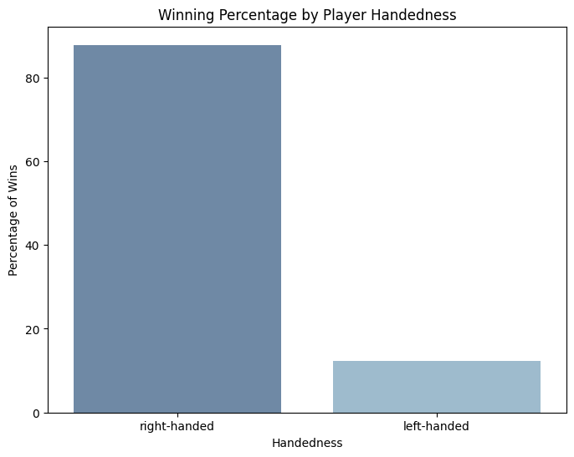

Slide 26
Question 6 :
Which country has produced the most successful tennis players?

Slide 27
Top 10 countries by number of match wins:
France 992
Italy 930
USA 889
Russia 621
Germany 557
Spain 540
Argentina 509
Japan 493
Australia 430
United Kingdom 355

Slide 28
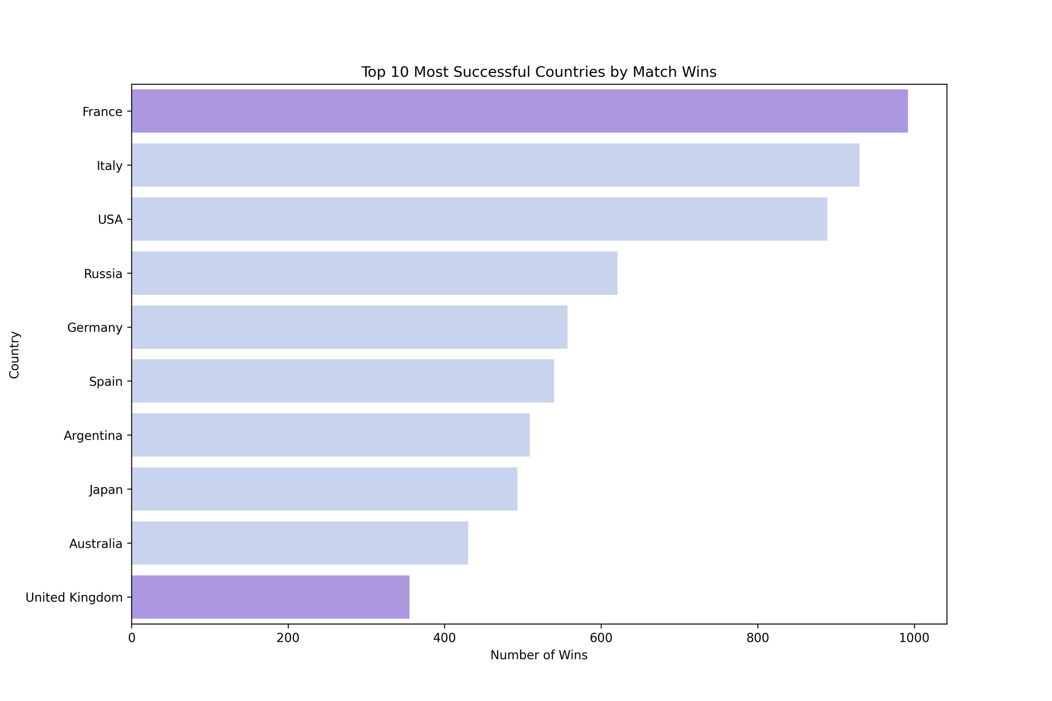

Slide 29
Top 10 countries with the best (lowest) current ranks: Poland 1.0
Serbia 1.0
Belarus 2.0
Italy 2.0
Spain 2.0
USA 3.0
Germany 4.0
Kazakhstan 4.0
Russia 4.0
Czech Republic 6.0

Slide 30
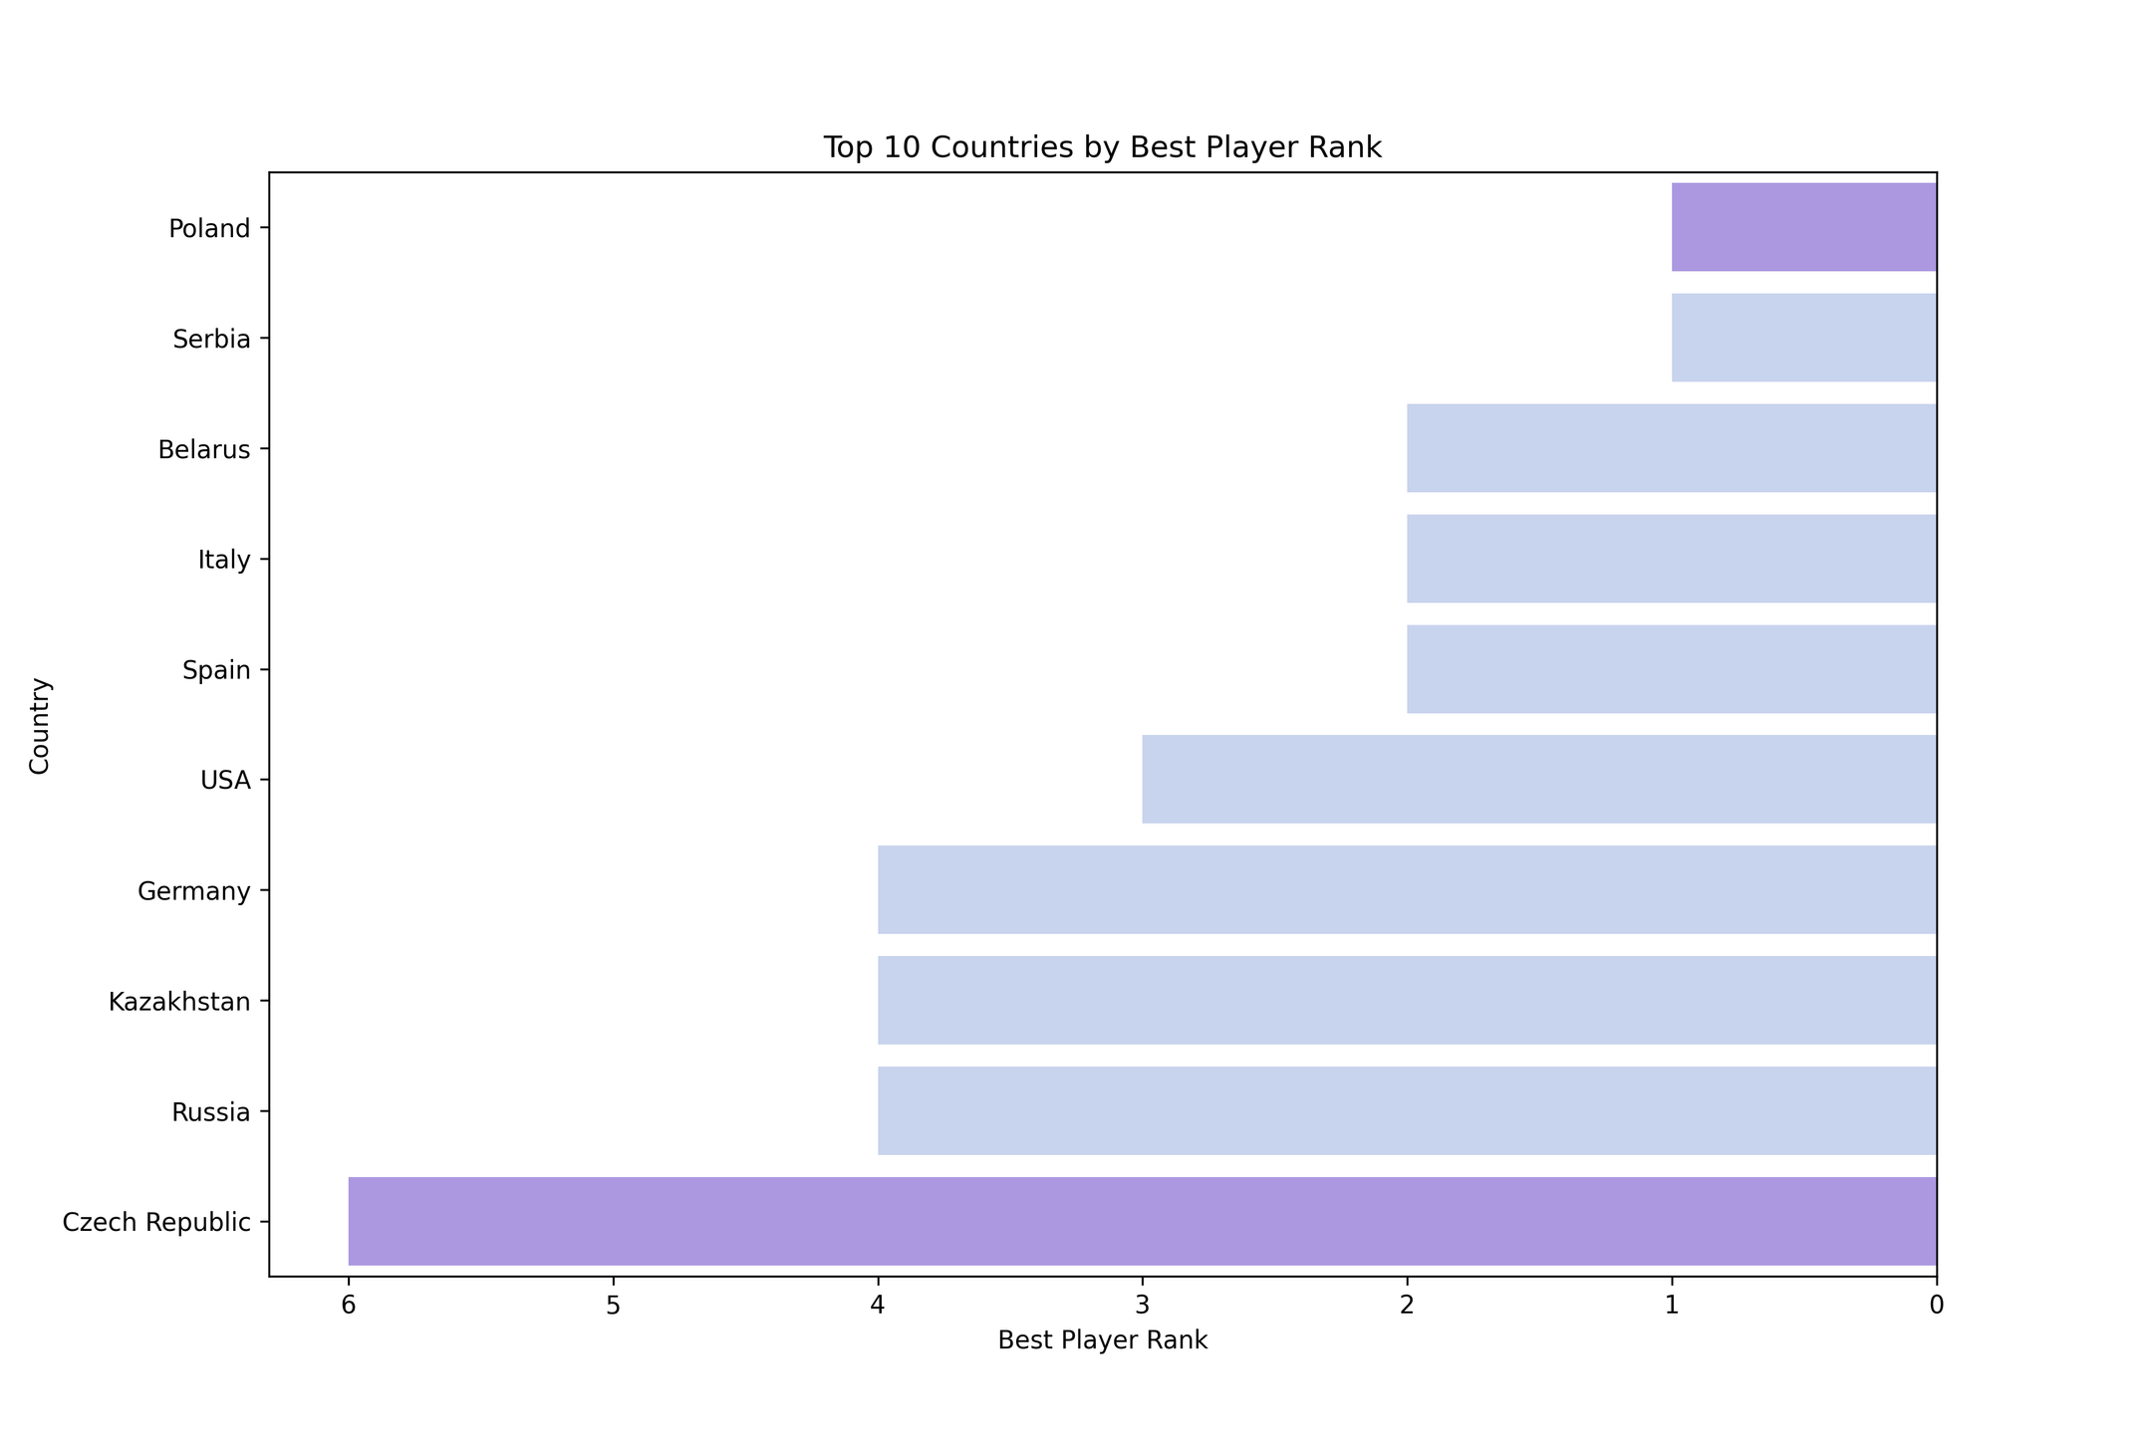

Slide 31
Question 7 :
What is the average number of aces per match?

Slide 32
Average number of aces per match: 3.43

Slide 33
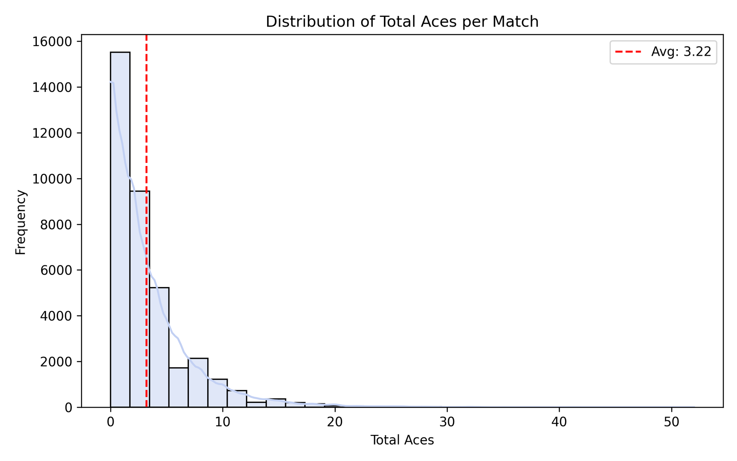

Slide 34
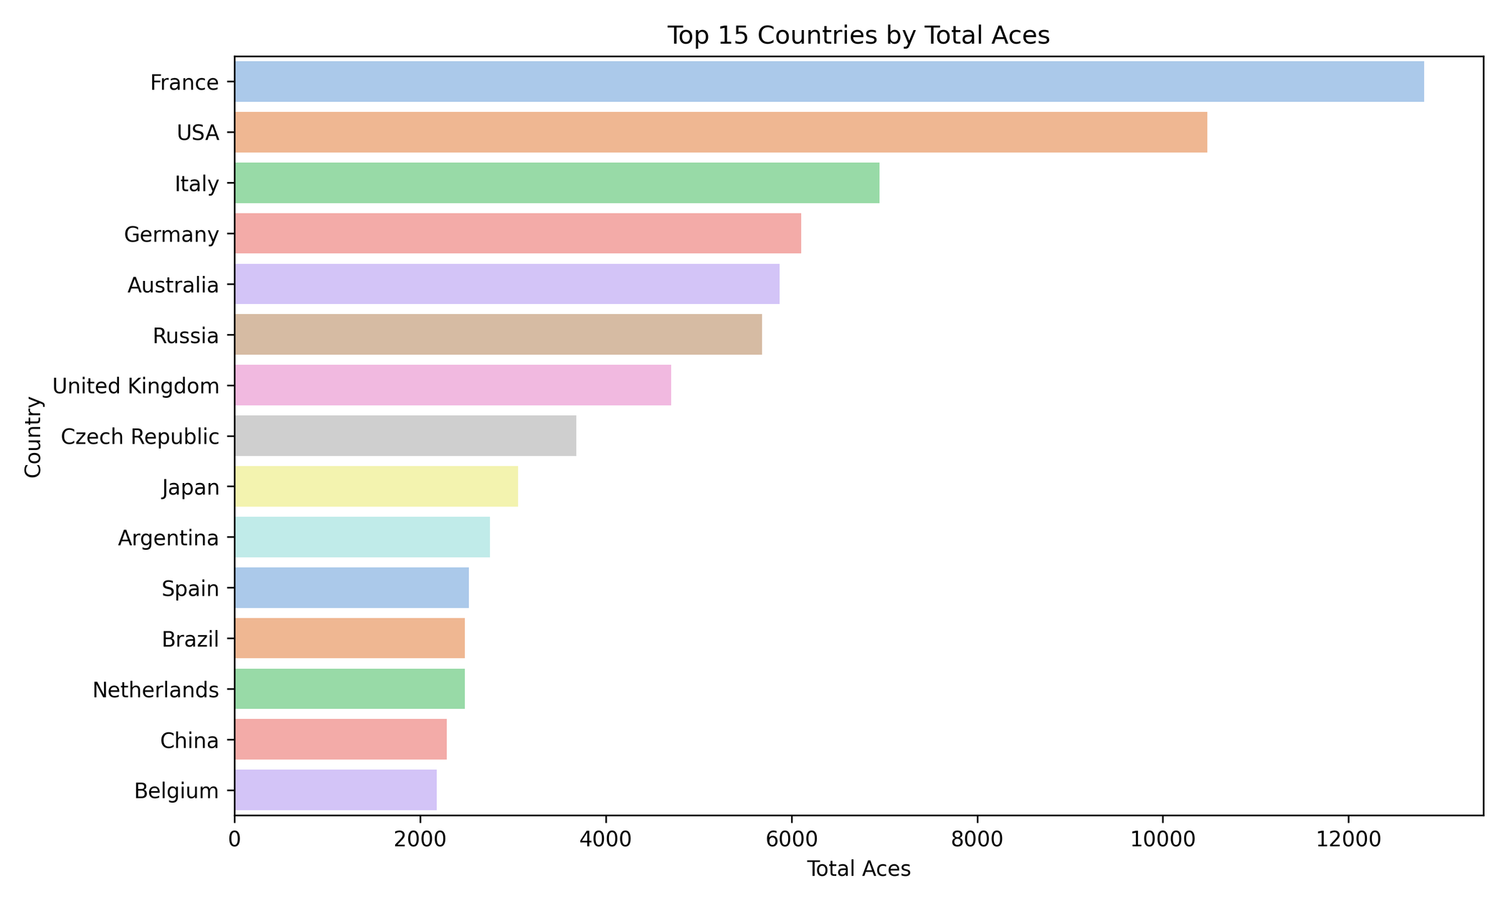

Slide 35
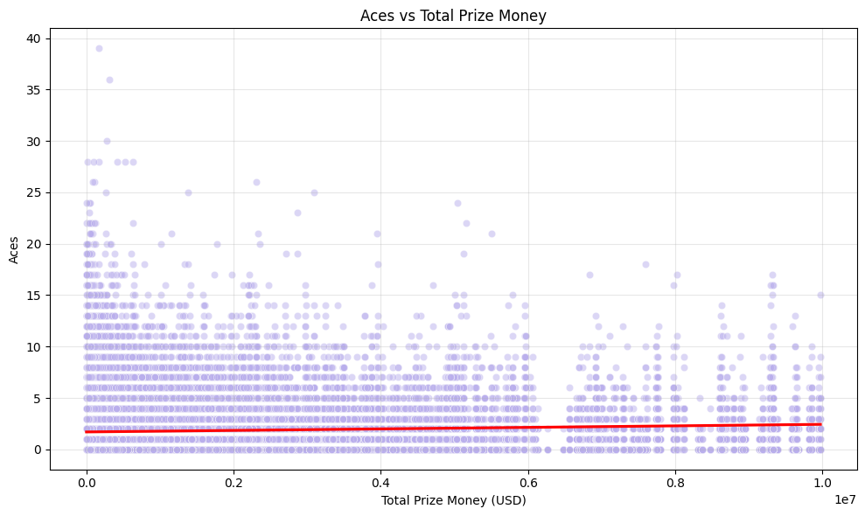

Slide 36
Question 8 :
Is there a difference in the number of double faults based on gender?

Slide 37
Descriptive Statistics by Gender
count mean std min 25% 50% 75% max
F 30950.0 2.107981 2.249022 0.0 0.0 2.0 3.0 28.0
M 40166.0 1.599064 1.801070 0.0 0.0 1.0 2.0 21.0

Slide 38
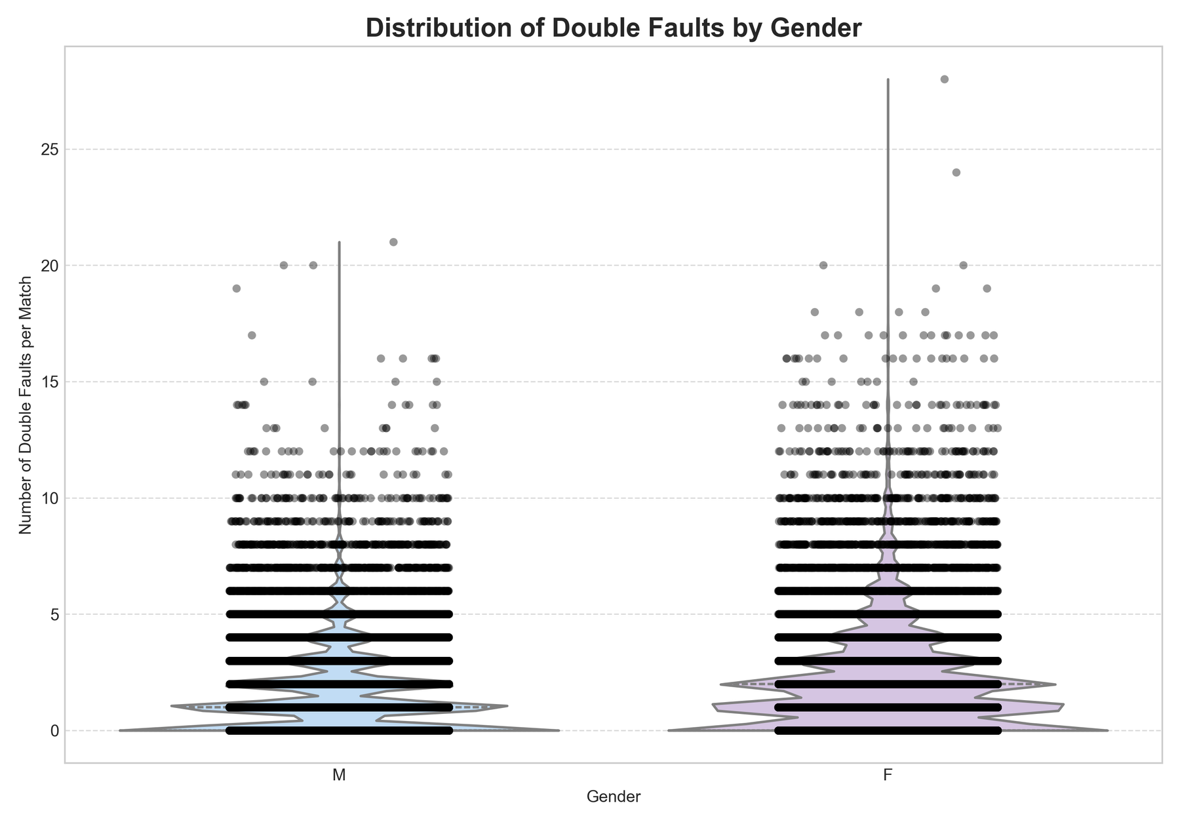

Slide 39
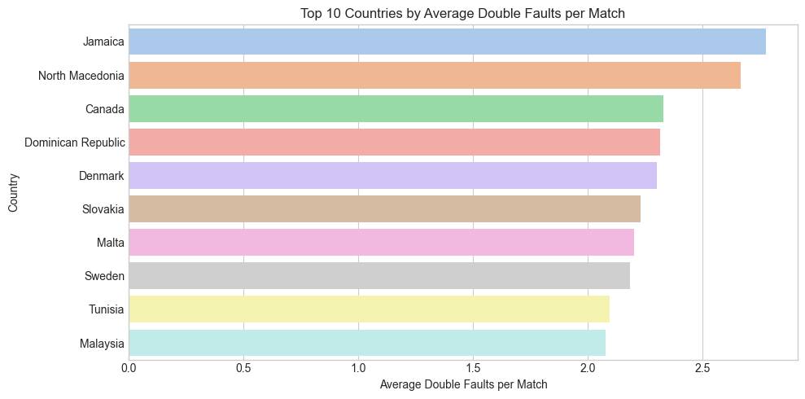

Slide 40
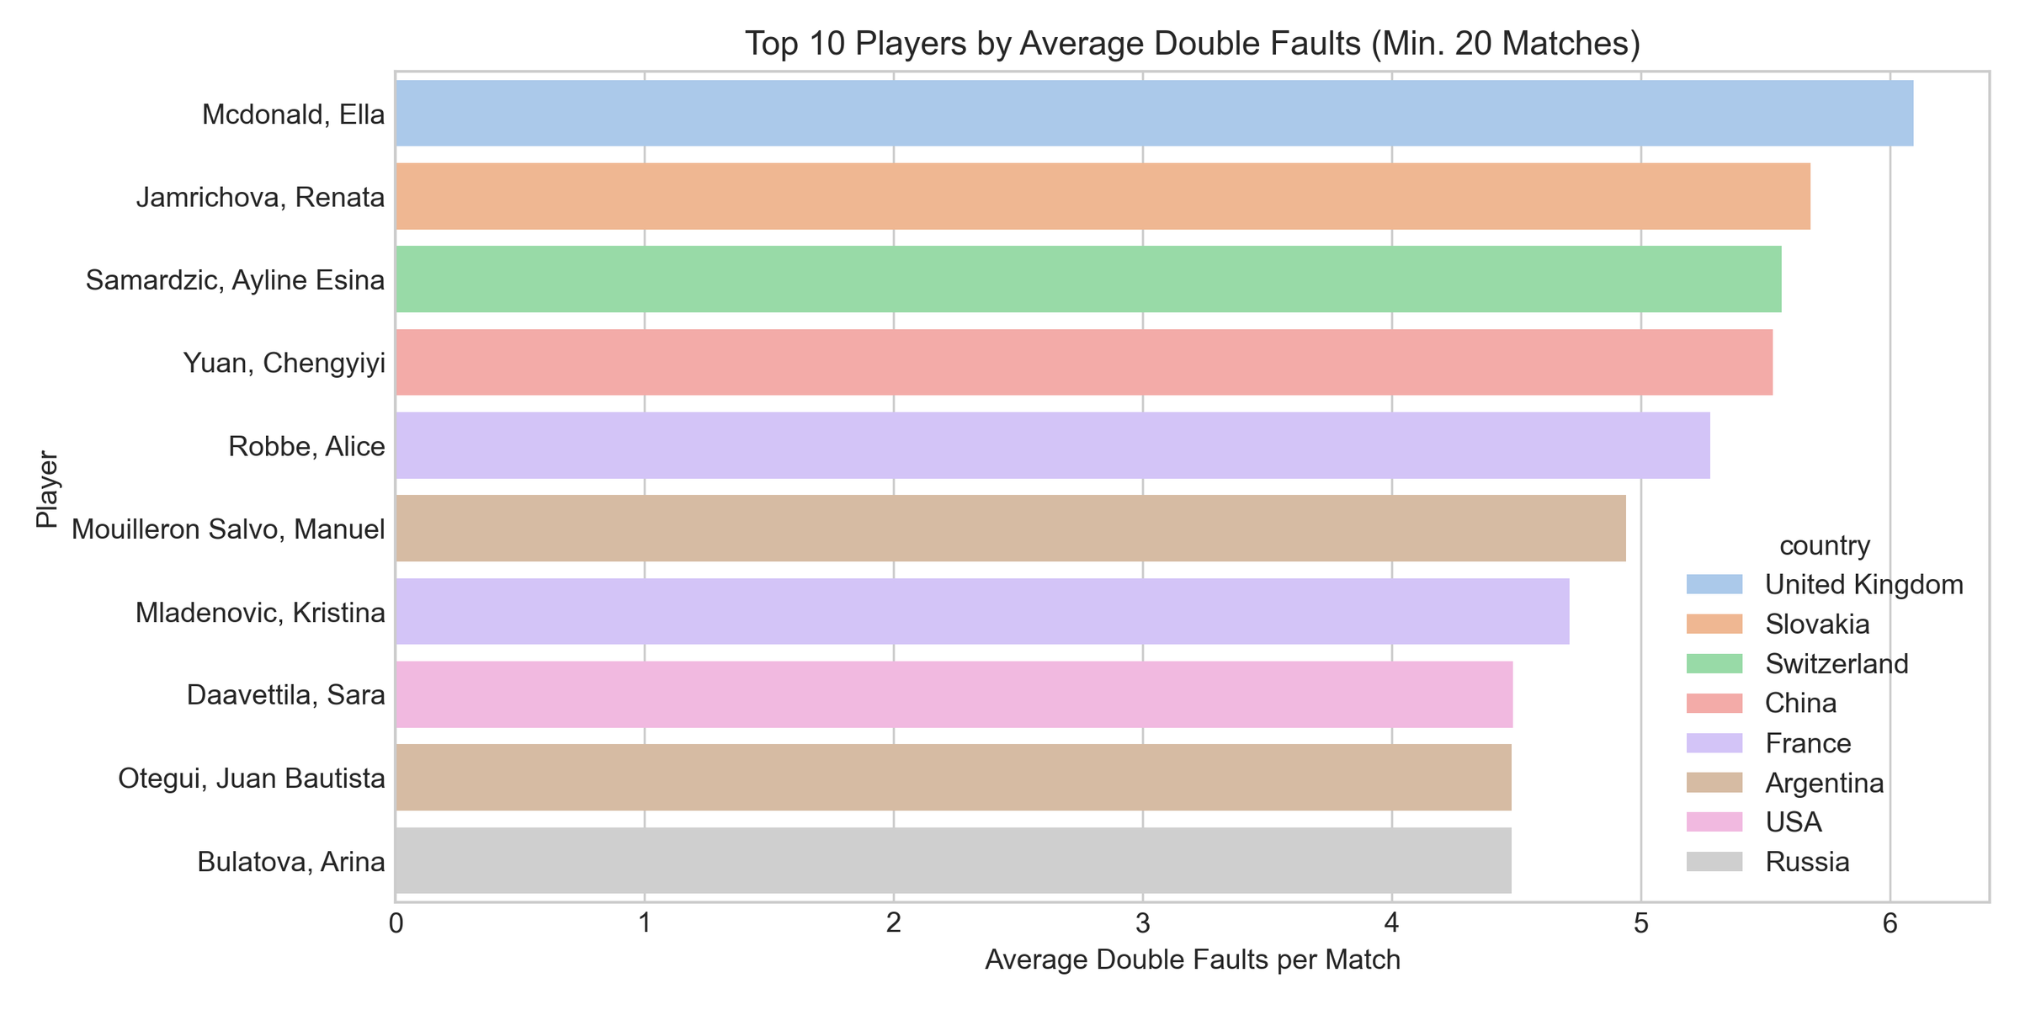

Slide 41
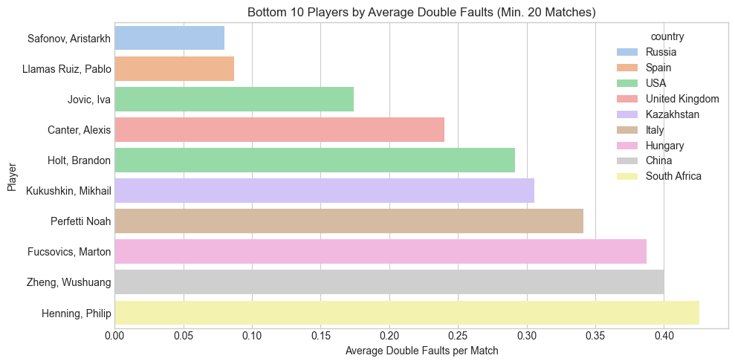

Slide 42
Question 9 :
Which player has won the most tournaments in a single month?

Slide 43
Player with most tournament wins in a single month: winner Chidekh C.
month 1970-01
tournament_wins 3

Slide 44
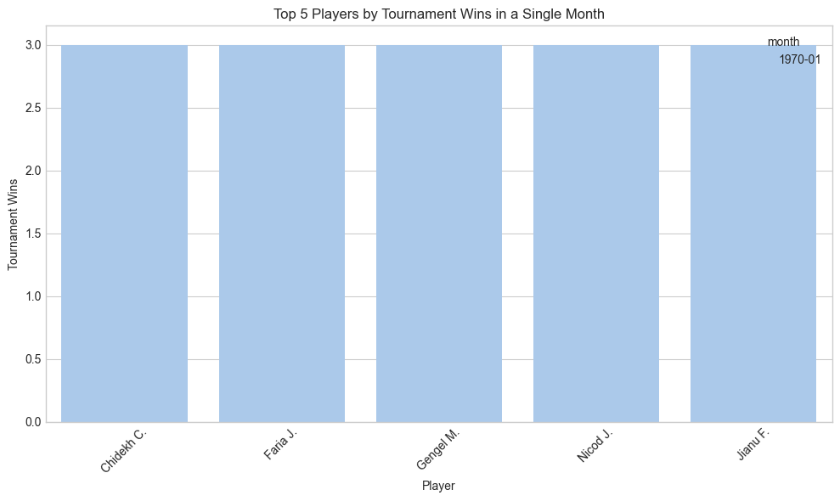

Slide 45
Question 10 :
Is there a correlation between a player's height and their ranking?

Slide 46
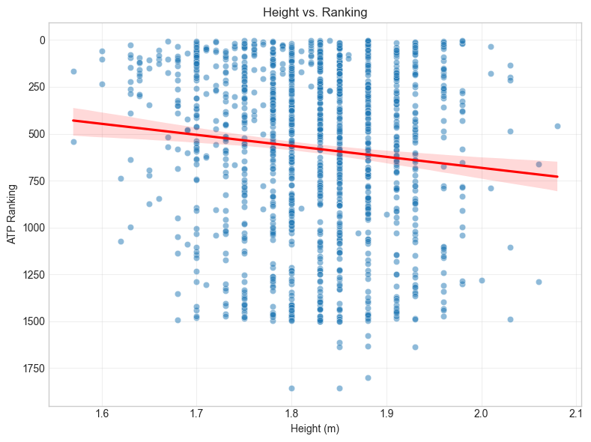

Slide 47
Question 11 :
What is the average duration of matches?

Slide 48
Average match duration (in minutes) by gender:
gender total_duration_min
F 109.349740
M 116.743139

Slide 49
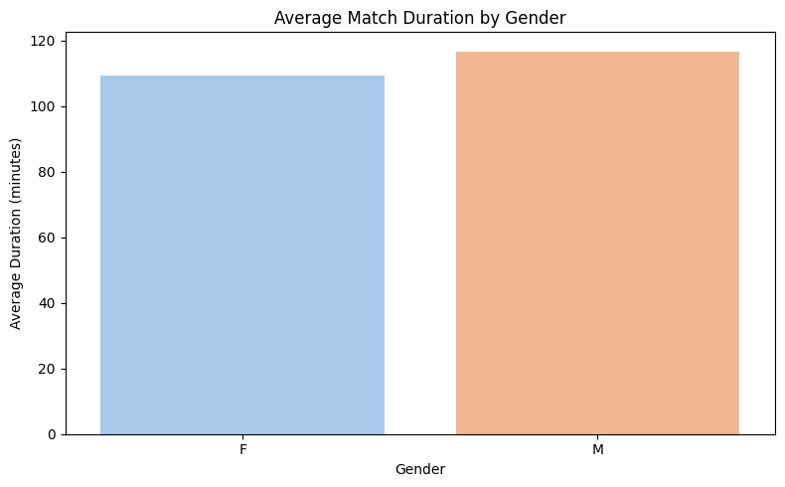

Slide 50
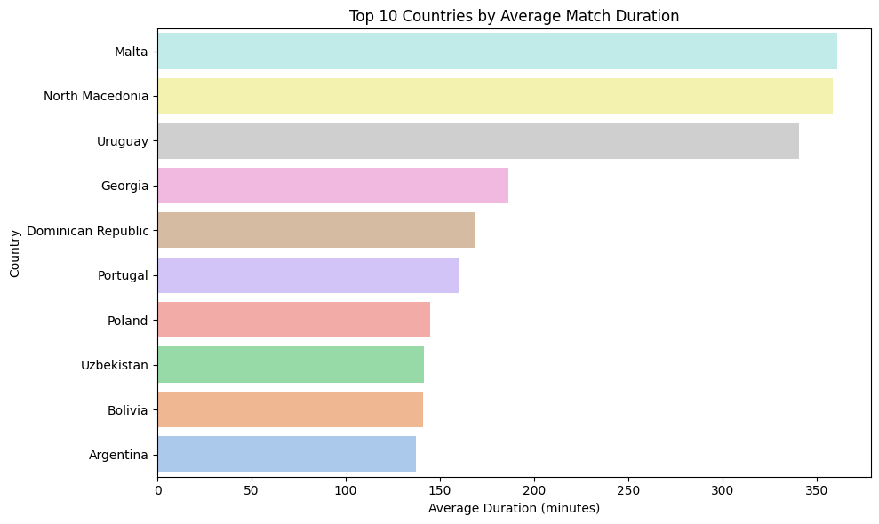

Slide 51
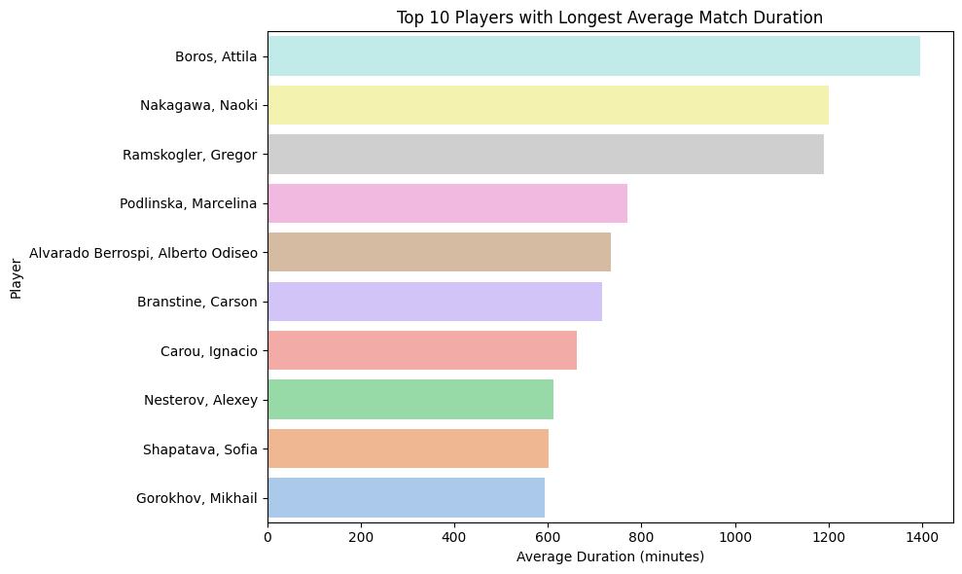

Slide 52
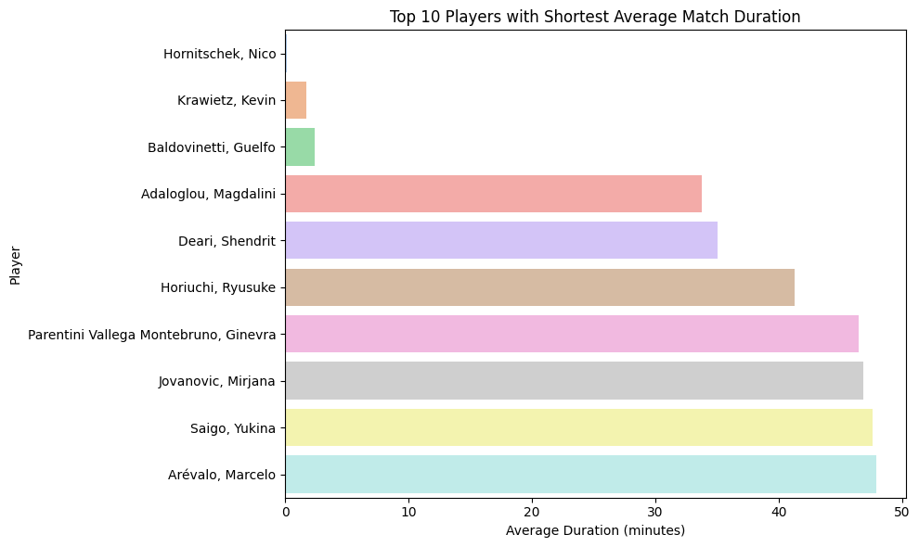

Slide 53
Question 12 :
What is the average number of games per set in men's matches compared to women's matches?

Slide 54
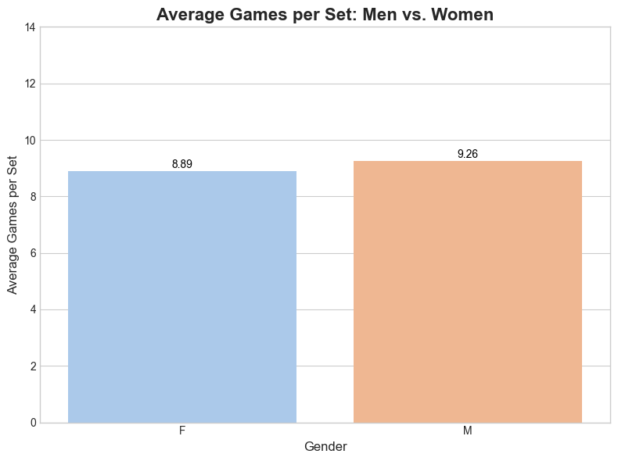

Slide 55
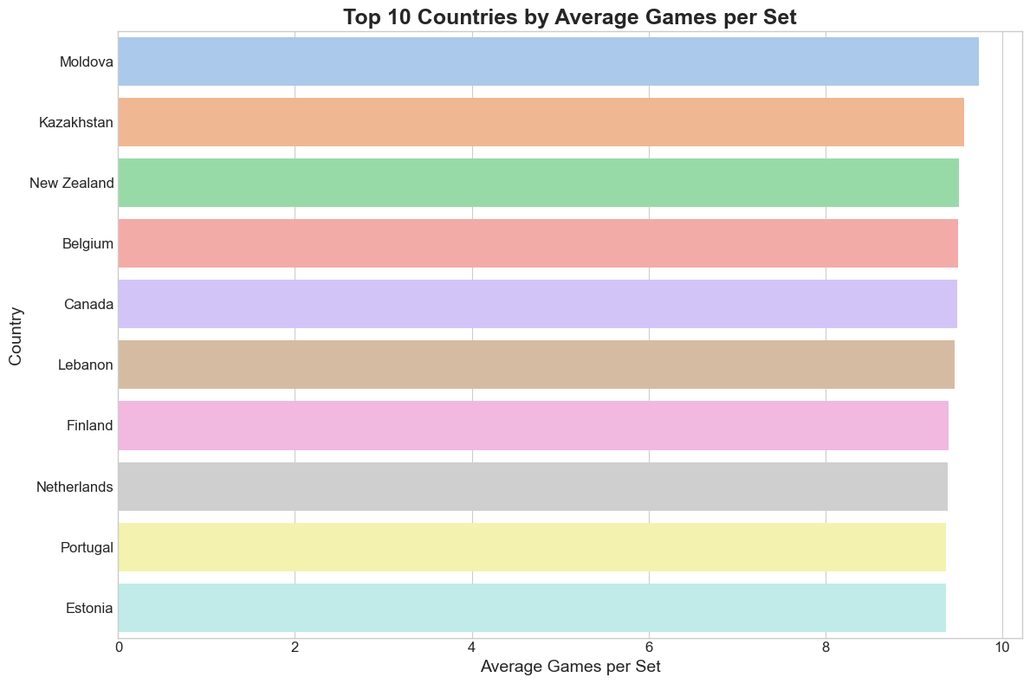

Slide 56
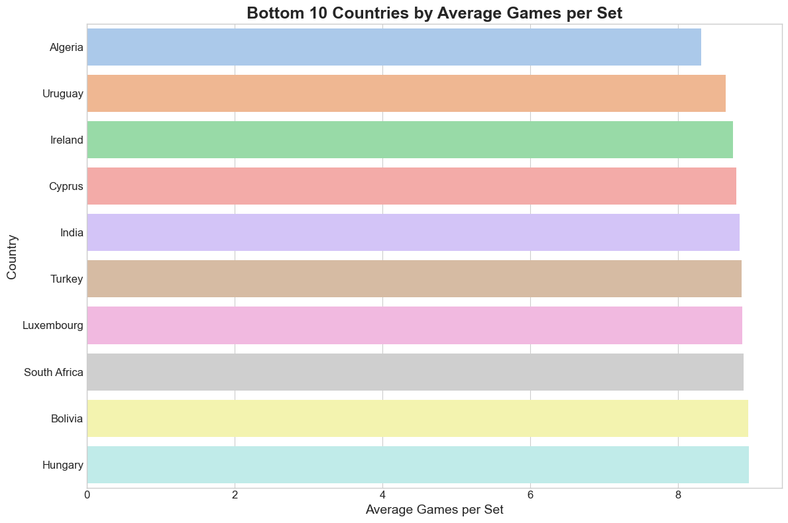

Slide 57
Question 13 :
What is the distribution of left-handed versus right-handed players?

Slide 58
plays
Right-handed 10424
Left-handed 1371

Slide 59
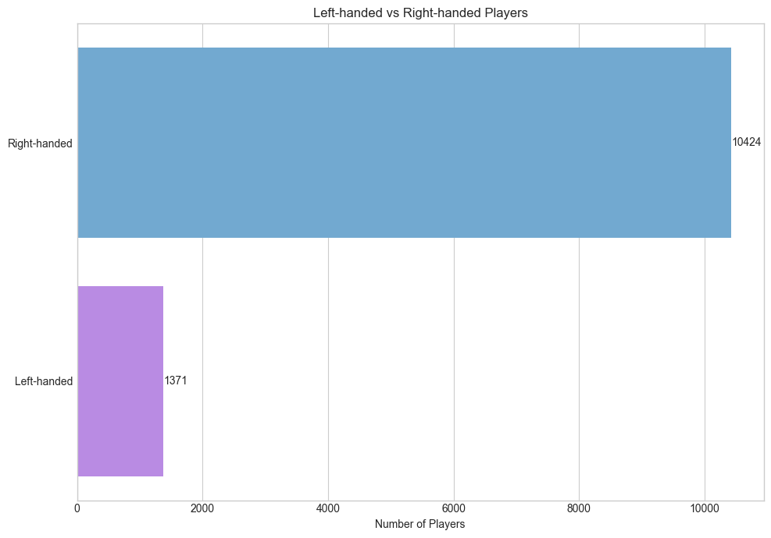

Slide 60
Question 14 :
What is the most common type of surface used in tournaments?

Slide 61
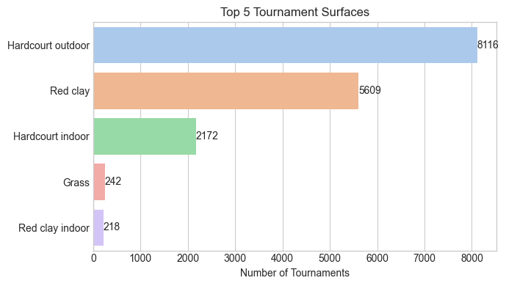

Slide 62
Question 15 :
How many distinct countries are represented in the dataset?

Slide 63
The number of distinct countries is: 101.

Slide 64
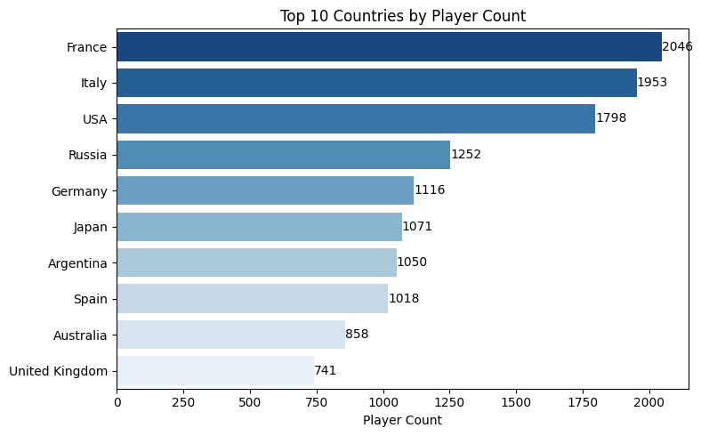

Slide 65
Question 16 :
Which player has the highest winning percentage against top 10 ranked opponents?

Slide 66
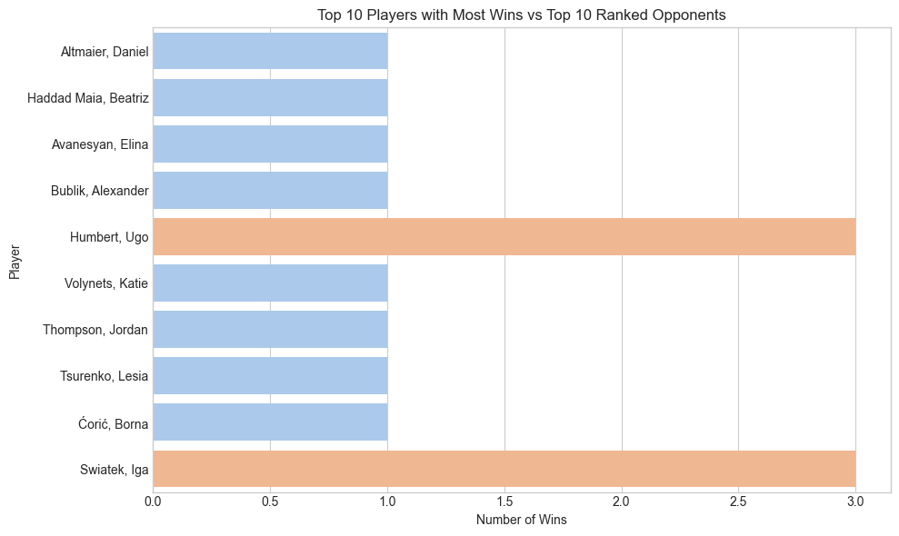

Slide 67
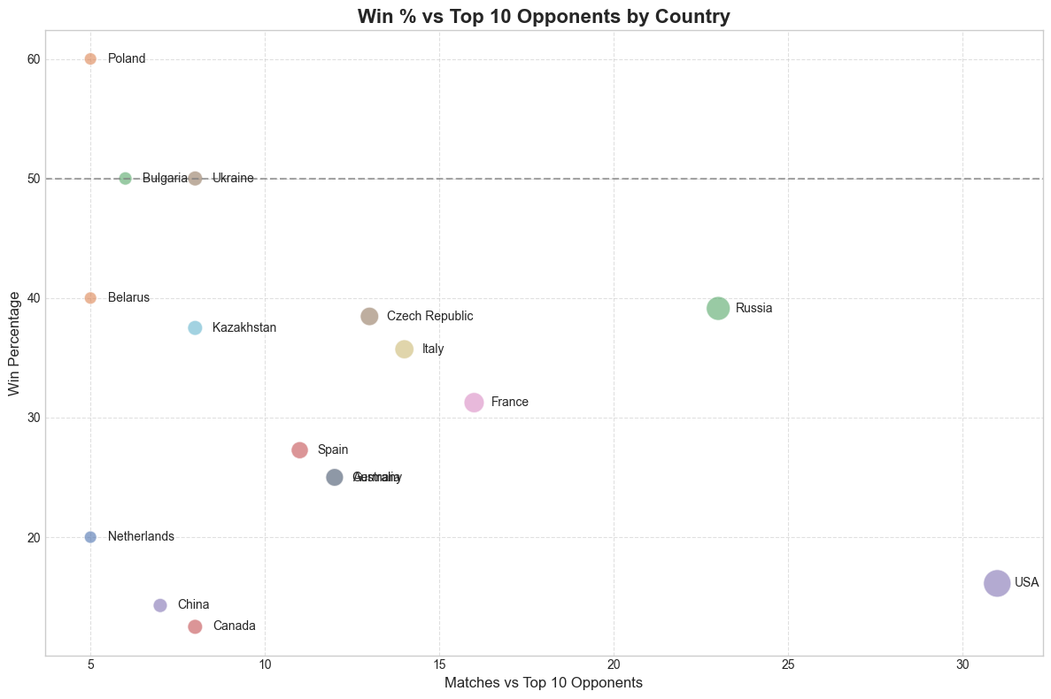

Slide 68
Question 17 :
What is the average number of breaks of serve per match?

Slide 69
Average Number of Breaks per Match: 6.93

Slide 70
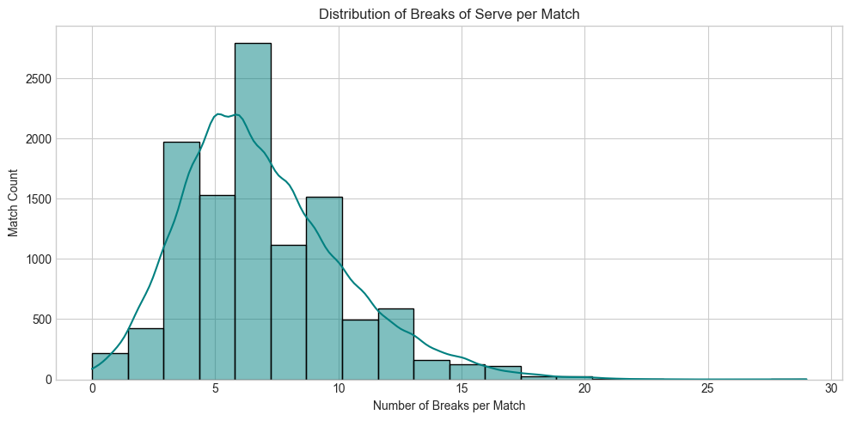

Slide 71
Average Number of Breaks per Match by Gender:
gender num_breaks
F 8.083681
M 6.033898

Slide 72
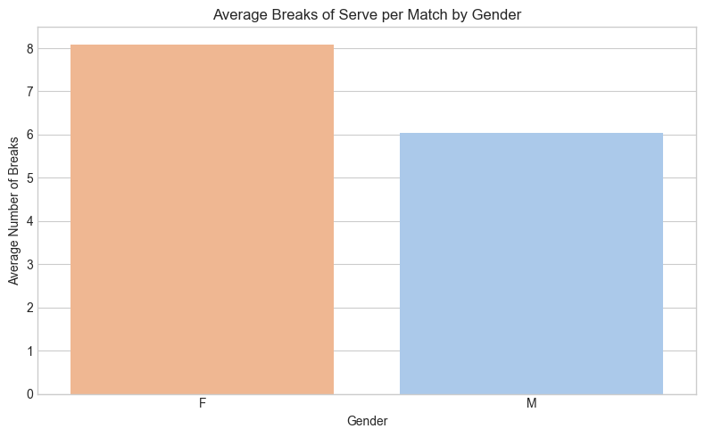

Slide 73
Thank you for your time.
link to the code:
https://github.com/marzi-dezfoulianrad/data_analysis_tennis

